Slide 1
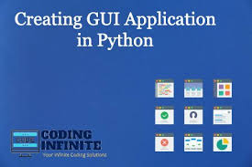
Unit-5
GUI (Graphical User Interface)

Slide 2
GUI (Graphical User Interface
GUI (Graphical User Interface) is the visual part of a program with buttons, windows, and text boxes.
GUI programming makes apps user-friendly by allowing users to click and interact visually.
In Python, libraries like Tkinter help create simple windows and buttons easily.

Slide 3
Steps for GUI Programming
Step 1: Import the GUI library (e.g., import tkinter as tk)
Step 2: Create the main window
Step 3: Add widgets (buttons, labels, text boxes)
Step 4: Define functions for user actions (like button clicks)
Step 5: Run the main loop to start the GUI

Slide 4
Tk() → Creates the main window
m = tk.Tk() # Creates the main window object named m
mainloop() → Runs the GUI program
m.mainloop() # Starts the program and keeps the window open until closed

Slide 5
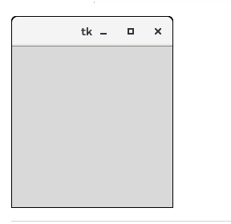
Example-
from tkinter import *
top = Tk()
top.mainloop()
Output:

Slide 6
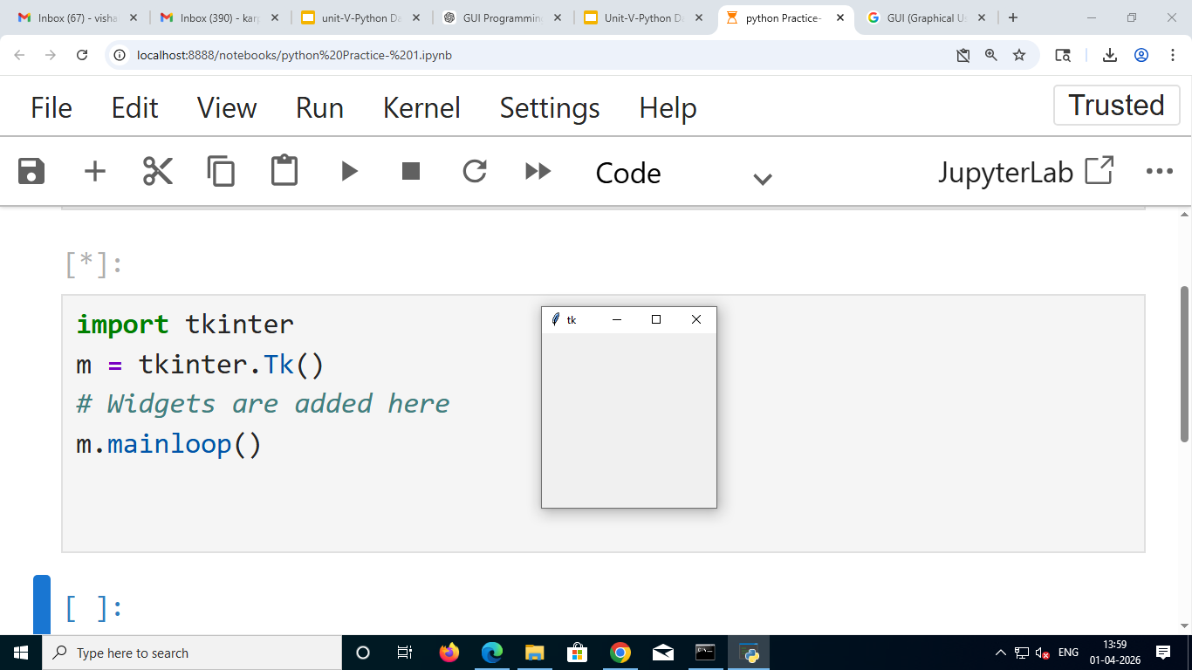
Tkinter Window Creation and Geometry Managers
Geometry Managers in Tkinter
Tkinter provides 3 geometry methods to arrange widgets in a window:
1 pack() – Arranges widgets in blocks (top, bottom, left, right).
2 grid() – Arranges widgets in rows and columns (table format).
3 place() – Places widgets at specific positions (x, y coordinates).

Slide 7

Python Tkinter pack() method
from tkinter import *
parent = Tk()
redbutton = Button(parent, text = "Red", fg = "red")
redbutton.pack( side = LEFT)
greenbutton = Button(parent, text = "Black", fg = "black")
greenbutton.pack( side = RIGHT )
bluebutton = Button(parent, text = "Blue", fg = "blue")
bluebutton.pack( side = TOP )
blackbutton = Button(parent, text = "Green", fg = "red")
blackbutton.pack( side = BOTTOM)
parent.mainloop()

Slide 8
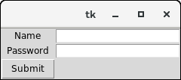
Python Tkinter grid() method
from tkinter import *
parent = Tk()
name = Label(parent,text = "Name").grid(row = 0, column = 0)
e1 = Entry(parent).grid(row = 0, column = 1)
password = Label(parent,text = "Password").grid(row = 1, column = 0)
e2 = Entry(parent).grid(row = 1, column = 1)
submit = Button(parent, text = "Submit").grid(row = 4, column = 0)
parent.mainloop()

Slide 9
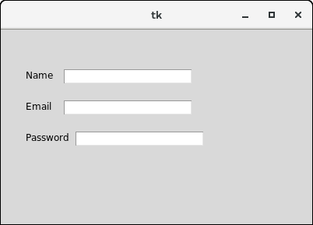
Python Tkinter place() method
from tkinter import *
top = Tk()
top.geometry("400x250")
name = Label(top, text = "Name").place(x = 30,y = 50)
email = Label(top, text = "Email").place(x = 30, y = 90)
password = Label(top, text = "Password").place(x = 30, y = 130)
e1 = Entry(top).place(x = 80, y = 50)
e2 = Entry(top).place(x = 80, y = 90)
e3 = Entry(top).place(x = 95, y = 130)
top.mainloop()

Slide 10
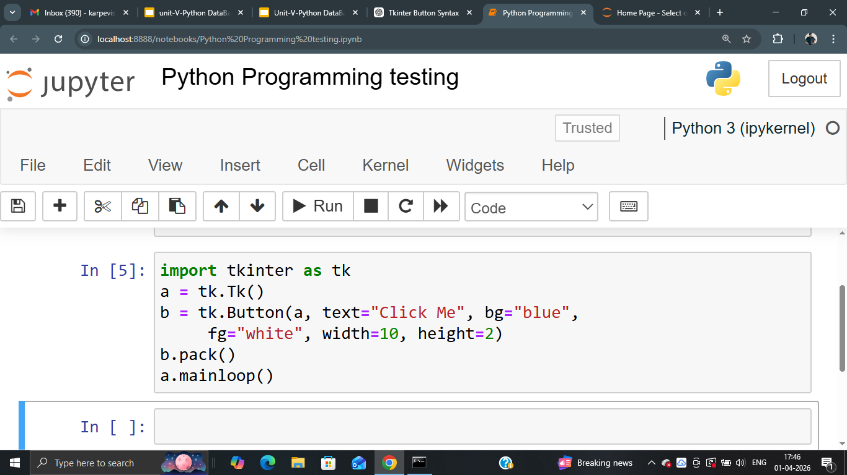
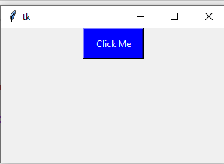
Tkinter 1) Button Widget
Syntax:v w = Button(master, option=value)

Slide 11
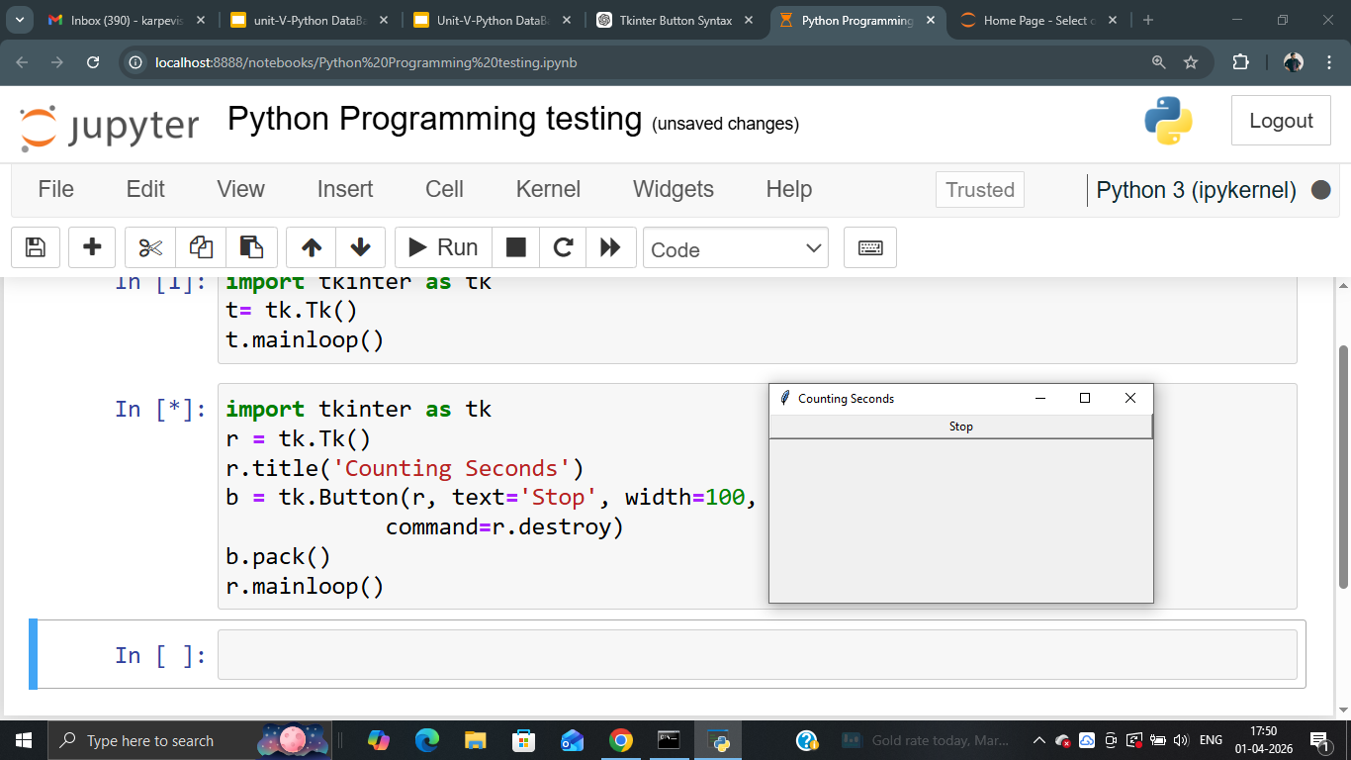
Tkinter Button Example (Close Window Button)

Slide 12
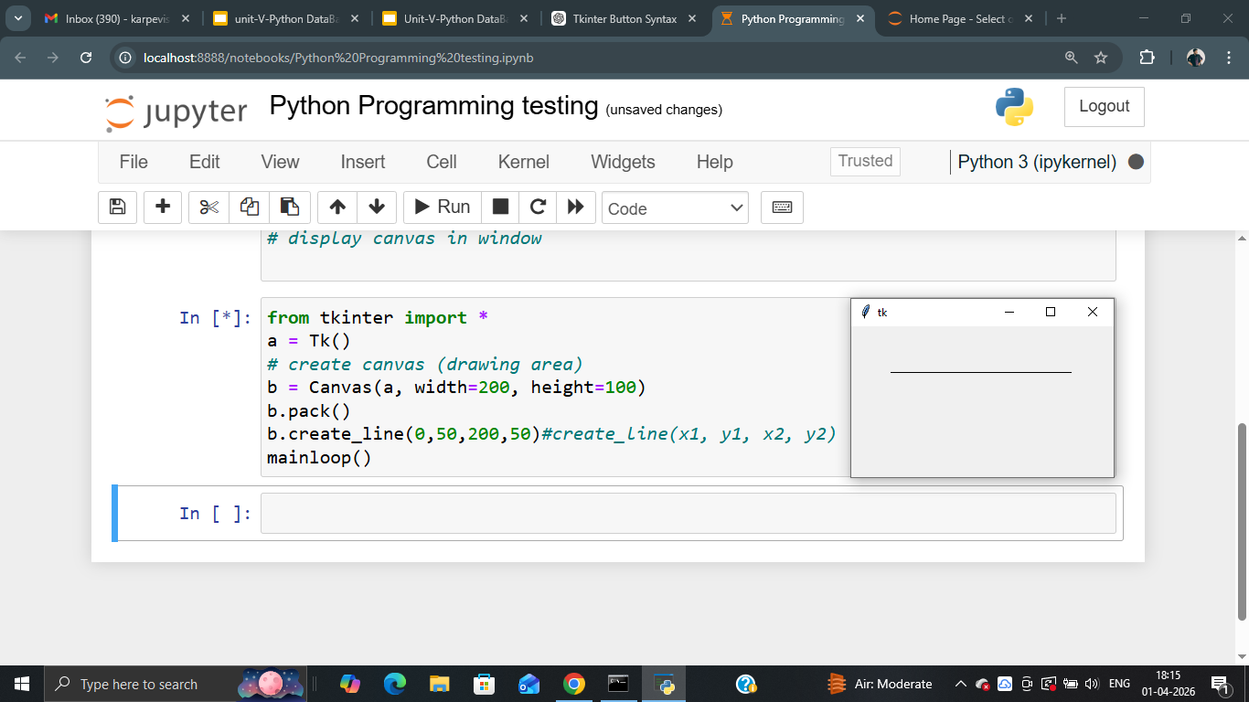
Tkinter 2. Canvas

Slide 13
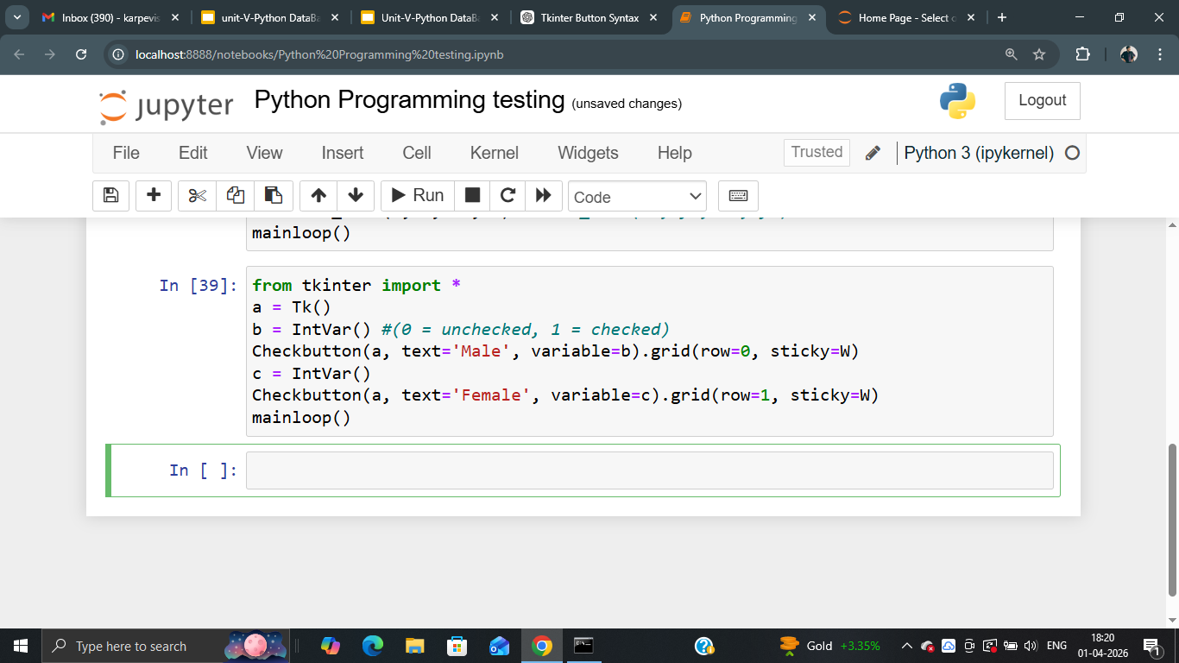
Tkinter 3. Checkbutton
Parameters:
text → label shown next to checkbox
variable → stores value (0 or 1)
row → position in grid (row number)
sticky=W → align to left side

Slide 14
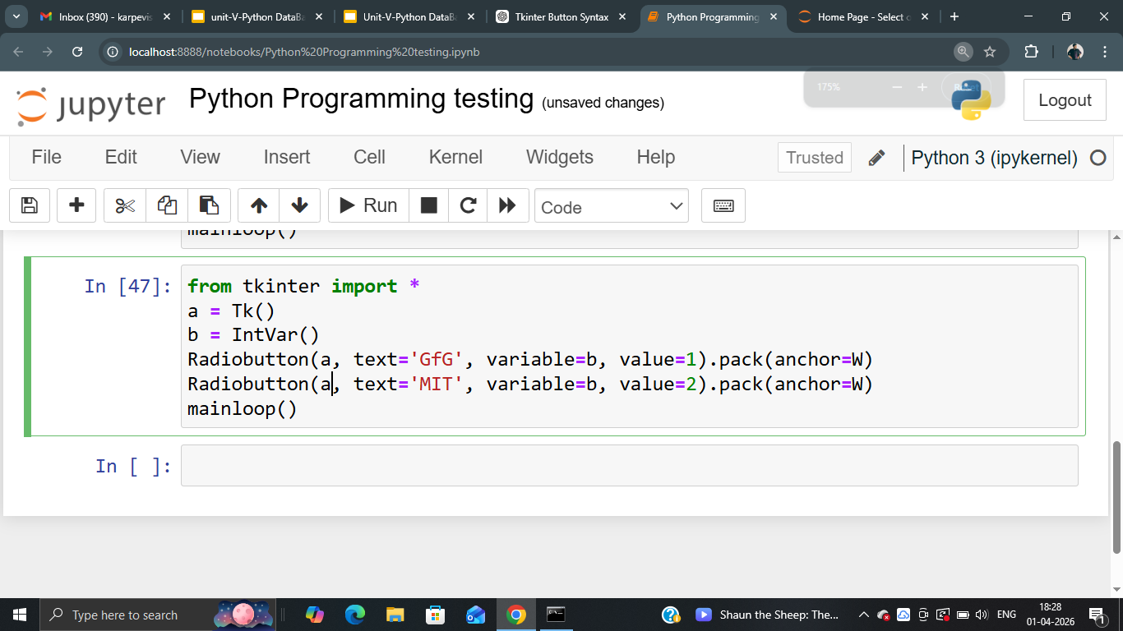
Tkinter 4. Radiobutton
text → option name variable → stores selected value
value → value for each option anchor=W → align to left

Slide 15
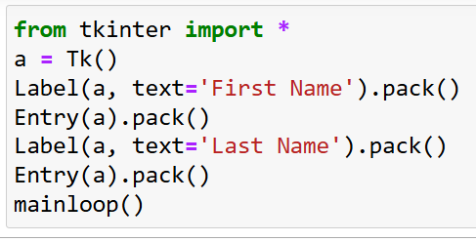
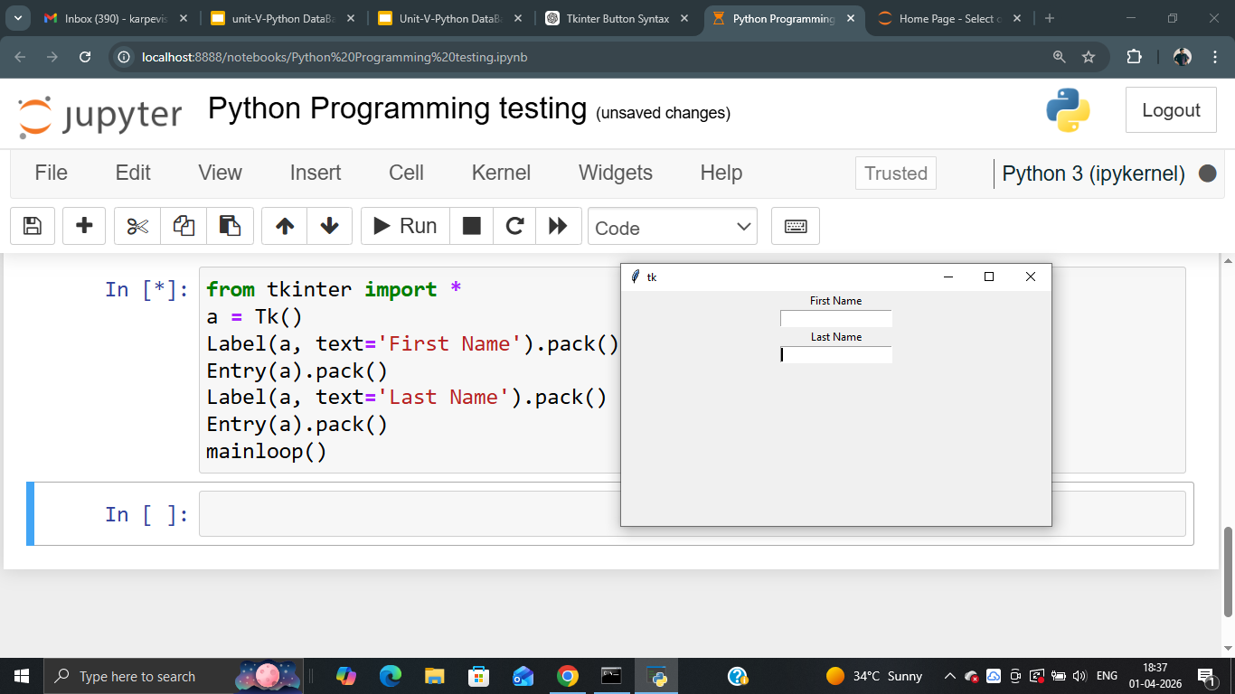
Tkinter 5. Entry (Input Box)
Label → shows text
Entry → input box
pack() → displays on screen

Slide 16
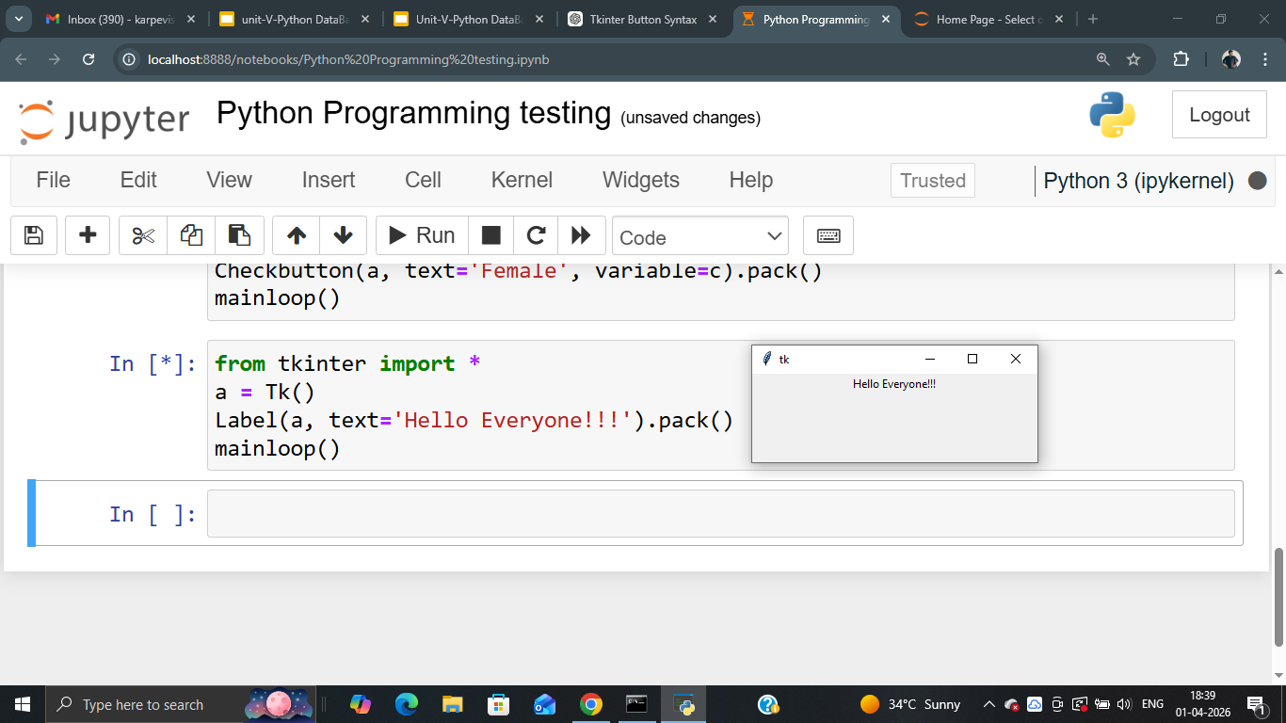
Tkinter 6. Label

Slide 17
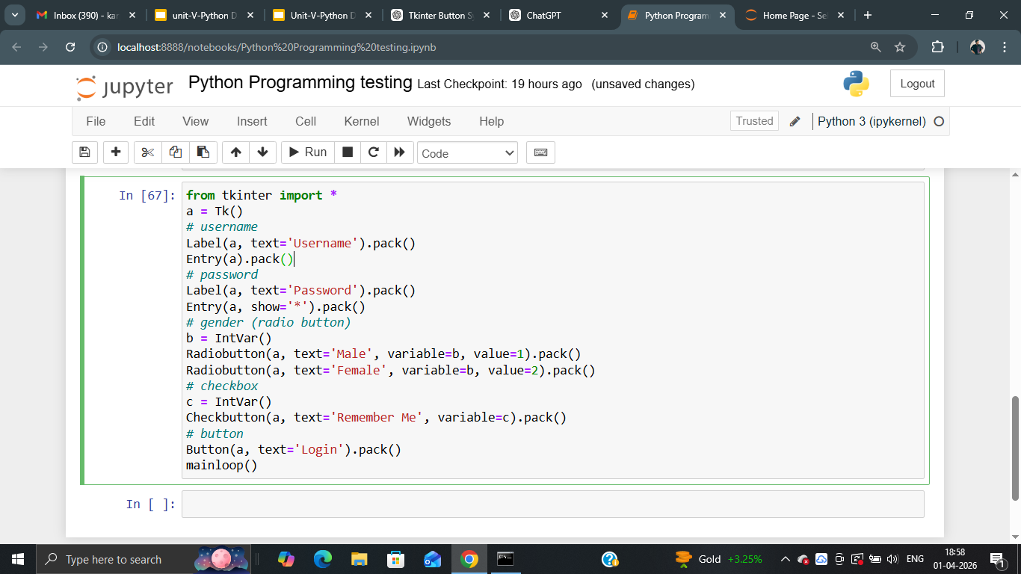
Q Create a simple Tkinter login form with username, password, gender selection, checkbox, and a login button.

Slide 18
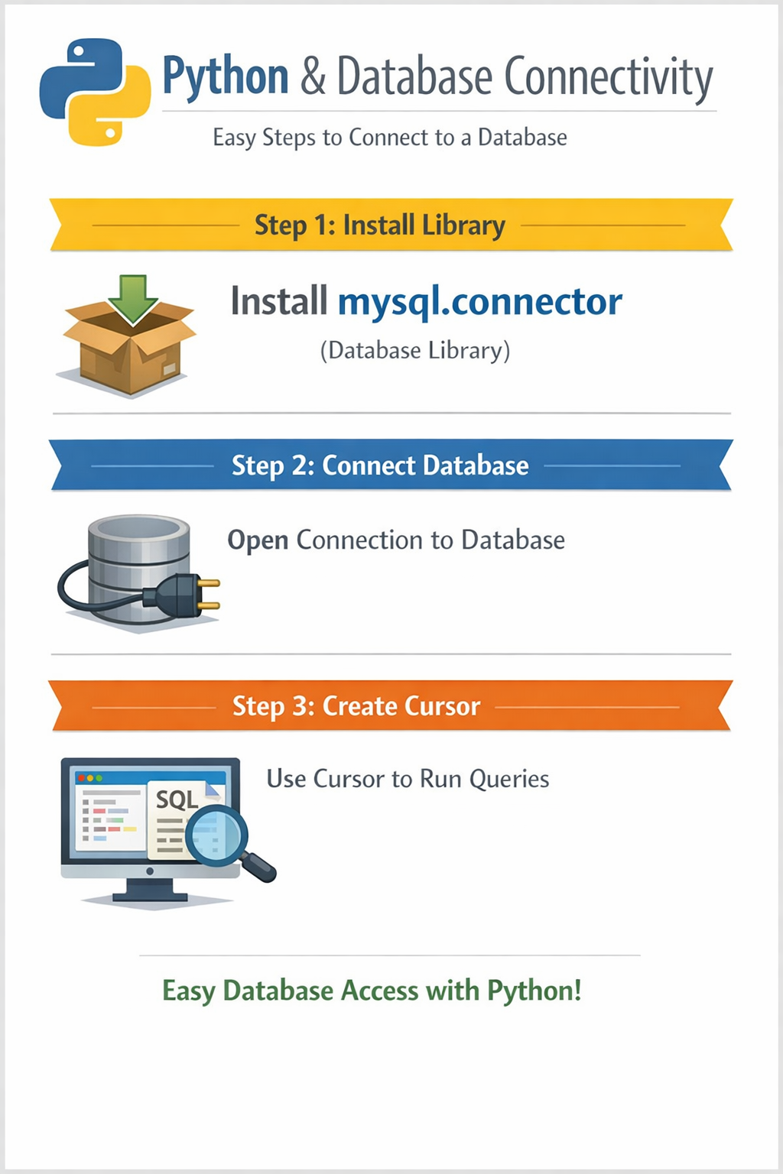
Database Operations and Connectivity

